Slide 1
CPA Security:
How to use a key multiple times
CS255: Winter 2026
Dan Boneh, Stanford University

Slide 2
Quick Recap
A block cipher is a pair of efficient algs. (E, D):
n bits
n bits
E, D
PT Block
CT Block
Key
k bits
Canonical examples:
AES: n=128 bits, k = 128, 192, 256 bits
(hardware support for many blocks in parallel)
3DES: n= 64 bits, k = 168 bits (historical)

Slide 3
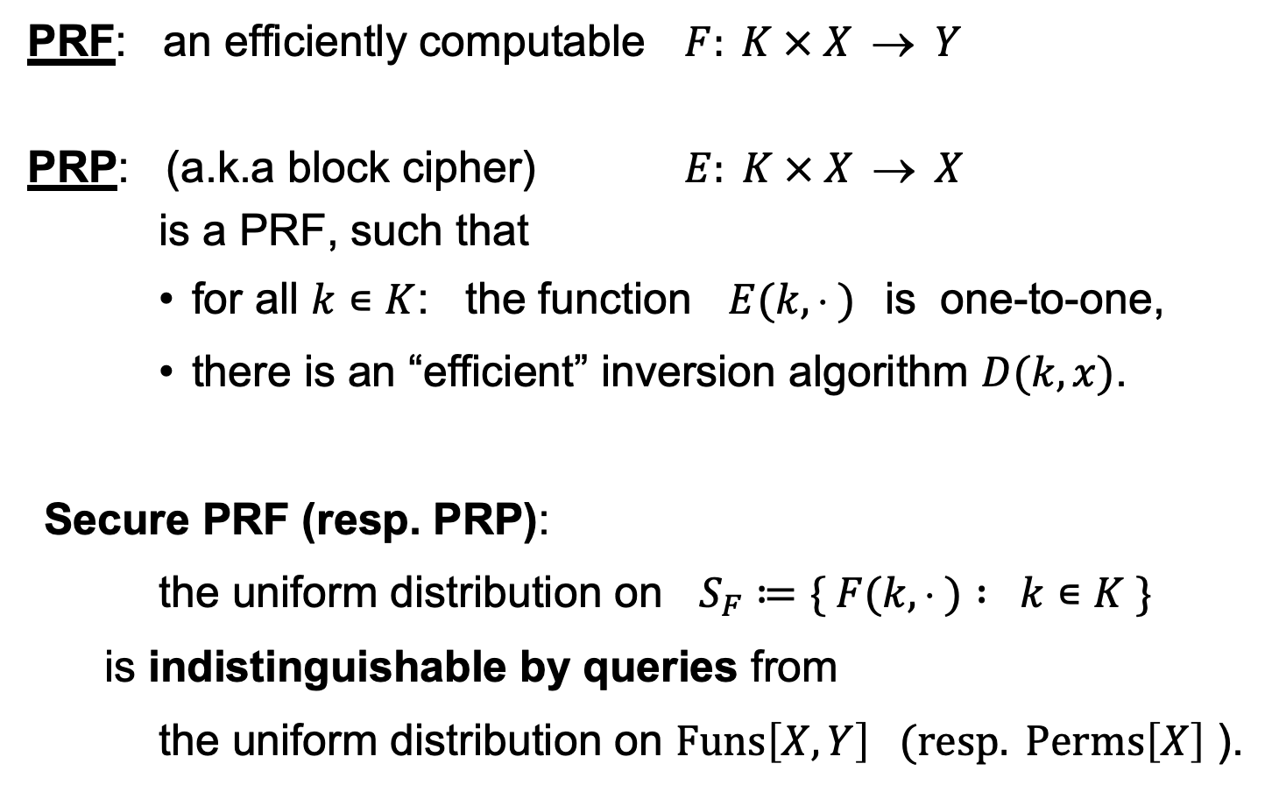
Abstract block ciphers: PRFs and PRPs
PRF: an efficiently computable $F: K × X  Y$
PRP: (a.k.a block cipher) $E: K × X  X$
is a PRF, such that
    for all $k∊K$: the function $E(k,  )$is one-to-one,
    there is an “efficient” inversion algorithm $D(k,x)$.
Secure PRF (resp. PRP):
the uniform distribution on $S_{F}≔\{ F(k,  ) : k∊K \}$
is indistinguishable by queries from
the uniform distribution on $Funs\left[X,Y\right] (resp. Perms\left[X\right]$ ).

Slide 4
ECB: Incorrect use of a PRP
Electronic Code Book (ECB):
Problem:
  if m₁=m₂ then c₁=c₂
PT:
m₁
m₂
CT:
c₁
c₂

Slide 5
Modes of Operation for
One-time Use Key
How to use a block cipher?
Example application:
Encrypted email. New key for every message.

Slide 6


Semantic Security for a one-time key
E = (E,D) a cipher defined over (K,M,C)
For b=0,1 define EXP(b) as:
Def: E is sem. sec. for one-time key if for all “efficient” $𝒜$:
Adv_{SS}[$𝒜$,E] = |Pr[EXP(0)=1] – Pr[EXP(1)=1] |
is “negligible.”
b
Chal.
Adv. $𝒜$
k←K
m₀ , m₁ ∈ M : |m₀| = |m₁|
c ← E(k, m_{b})
b’ ∈ {0,1}

Slide 7
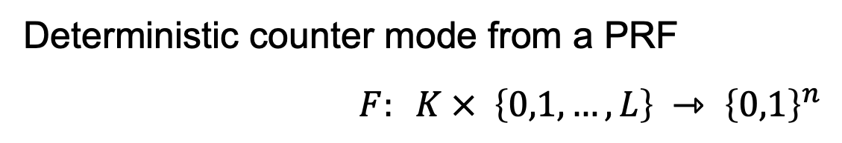
A Semantically Secure Scheme
Deterministic counter mode from a PRF
$F: K × \left\{0,1,…,L\right\} ⇾ {\left\{0,1\right\}}^{n}$
E_{DETCTR} (k,m) =
    ⇒ Stream cipher built from PRF (e.g. AES)
m[0]
m[1]
…
m[L]
⊕
F(k,0)
F(k,1)
…
F(k,L)
indist. from
a OTP
c[0]
c[1]
…
c[L]

Slide 8
Modes of Operation for
Many-time Key
How to use a block cipher?
Example applications:
1. File systems: Same AES key used to encrypt many files.
2. IPsec: Same AES key used to encrypt many packets.

Slide 9


Semantic Security for many-time key (CPA security)
Cipher E = (E,D) defined over (K,M,C).
For b=0,1 define EXP(b) as:
Def: E is sem. sec. under CPA if for all “efficient” $𝒜$:
Adv_{CPA} [$𝒜$,E] = |Pr[EXP(0)=1] – Pr[EXP(1)=1] |
is “negligible.”
b ∈ {0,1}
for i=1,…,q:
Chal.
Adv. $𝒜$
k←K
m_{i,0} , m_{i,1} ∈ M : |m_{i,0}| = |m_{i,1}|
c_{i} ← E(k, m_{i,b})
b’ ∈ {0,1}
if adv. wants c = E(k, m) it queries with m_{j,0}= m_{j,1}=m

Slide 10
Security for many-time key
Fact: stream ciphers are insecure under CPA.
  More generally: if E(k,m) always produces same ciphertext, then cipher is insecure under CPA.
If secret key is to be used multiple times ⇒
given the same plaintext message twice,
the encryption alg. must produce different outputs.
Chal.
m₀ , m₀ ∈ M
Adv.
k←K
c₀ ←E(k, m₀)
m₀ , m₁ ∈ M
output 0
if c = c₀
c ← E(k, m_{b})

Slide 11
Nonce-based Encryption
nonce
Alice
Bob
m, n
E
E(k,m,n)=c
c, n
D
D(k,c,n)=m
k
k
nonce n: a value that changes from msg to msg
  (k,n) pair never used more than once
method 1: encryptor chooses a random nonce, n ← N
method 2: nonce is a counter (e.g. packet counter)
  used when encryptor keeps state from msg to msg
  if decryptor has same state, need not send nonce with CT
Notes:
File encryption: random nonce, no state from file to file
SSL encrytpion (in order delivery): counter is fine, no need to send nonce to peer.
IP sec (out of order delivery): counter is fine, but need to include nonce in every packet.

Slide 12
Construction 1: CBC with random nonce
Cipher block chaining with a random IV (IV = nonce)
IV
m[0]
m[1]
m[2]
m[3]
⊕
⊕
⊕
⊕
E(k,⋅)
E(k,⋅)
E(k,⋅)
E(k,⋅)
IV
c[0]
c[1]
c[2]
c[3]
ciphertext
note: CBC where attacker can predict the IV is not CPA-secure. HW.

Slide 13
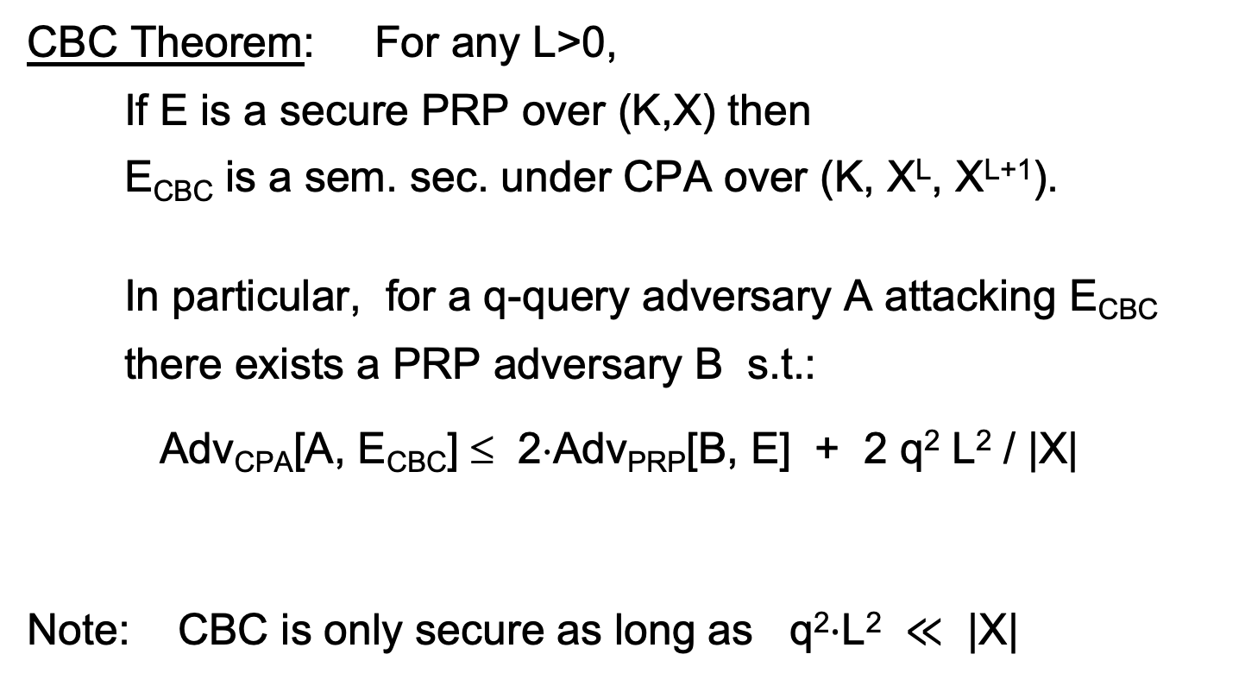
CBC: CPA Analysis
CBC Theorem: For any L>0,
If E is a secure PRP over (K,X) then
E_{CBC} is a sem. sec. under CPA over (K, X^{L}, X^{L+1}).
In particular, for a q-query adversary A attacking E_{CBC}
there exists a PRP adversary B s.t.:
Adv_{CPA}[A, E_{CBC}] ≤ 2⋅Adv_{PRP}[B, E] + 2 q² L² / |X|
Note: CBC is only secure as long as q²⋅L² $≪$ |X|
# messages enc. with key
max msg length

Slide 14
Construction 1’: CBC with unique nonce
Cipher block chaining with unique IV (IV = nonce)
unique IV means: (key,IV) pair is used for only one message
IV
m[0]
m[1]
m[2]
m[3]
IV′
⊕
⊕
⊕
⊕
E(k₂,⋅)
E(k₁,⋅)
E(k₁,⋅)
E(k₁,⋅)
E(k₁,⋅)
IV
c[0]
c[1]
c[2]
c[3]
ciphertext
included only if unknown to decryptor

Slide 15
A CBC technicality: padding
IV
m[0]
m[1]
m[2]
m[3] ll pad
IV′
⊕
⊕
⊕
⊕
E(k₁,⋅)
E(k,⋅)
E(k,⋅)
E(k,⋅)
E(k,⋅)
IV
c[0]
c[1]
c[2]
c[3]
pad is
removed
during
decryption
TLS 1.0: if need n-byte pad, n>0, use:
if no pad needed, add a dummy block
n-1
n-1
⋯
n-1
Notes:
Solution: ciphertext stealing, but not discussed here.
Later: when removing pad must verify its structure, otherwise Poodle attack.

Slide 16

Construction 2: rand ctr-mode
F: PRF defined over (K,X,Y) where X = $\{0,1,…,2n$-$1\}$and Y = $\{0,1\}n$
(e.g., n=128)
msg
IV
m[0]
m[1]
…
m[L]
⊕
F(k,IV)
F(k,IV+1)
…
F(k,IV+L)
(counter counts mod $2^{n}$)
IV
c[0]
c[1]
…
c[L]
ciphertext
IV - chosen at random for every message
note: parallelizable (unlike CBC)

Slide 17
Why is this CPA secure?
the set X: domain of PRF
IV₃
IV₃+1
⋯
IV₃+L
msg3
IV₁
IV₁+1
⋯
IV₁+L
msg1
msg5
msg4
IV₂
IV₂+1
⋯
IV₂+L
msg2
CPA security holds as long as intervals do not intersect
q msgs, L blocks each ⇒ Pr[ intersection ] ≤ 2 q² L / |X|
needs to be negligible

Slide 18
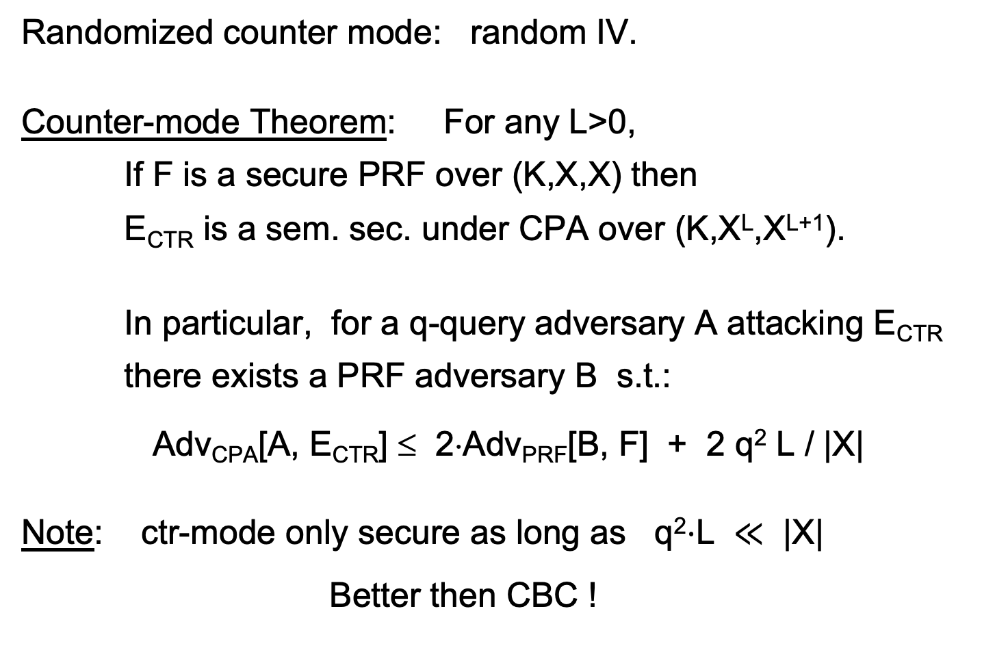
rand ctr-mode: CPA analysis
Randomized counter mode: random IV.
Counter-mode Theorem: For any L>0,
If F is a secure PRF over (K,X,X) then
E_{CTR} is a sem. sec. under CPA over (K,X^{L},X^{L+1}).
In particular, for a q-query adversary A attacking E_{CTR}
there exists a PRF adversary B s.t.:
Adv_{CPA}[A, E_{CTR}] ≤ 2⋅Adv_{PRF}[B, F] + 2 q² L / |X|
Note: ctr-mode only secure as long as q²⋅L $≪$ |X|
Better then CBC !

Slide 19
An example
Adv_{CPA} [A, E_{CTR}] ≤ 2⋅Adv_{PRF}[B, E] + 2 q² L / |X|
q = # messages encrypted with k , L = length of max msg
Suppose we want Adv_{CPA}[A, E_{CTR}] ≤ 1/ 2³¹
Then need: q² L / |X| ≤ 1/ 2³²
AES: |X| = 2¹²⁸ ⇒ q L^{1/2} < 2⁴⁸
So, after 2³² CTs each of len 2³² , must change key
(total of 2⁶⁴ AES blocks)

Slide 20
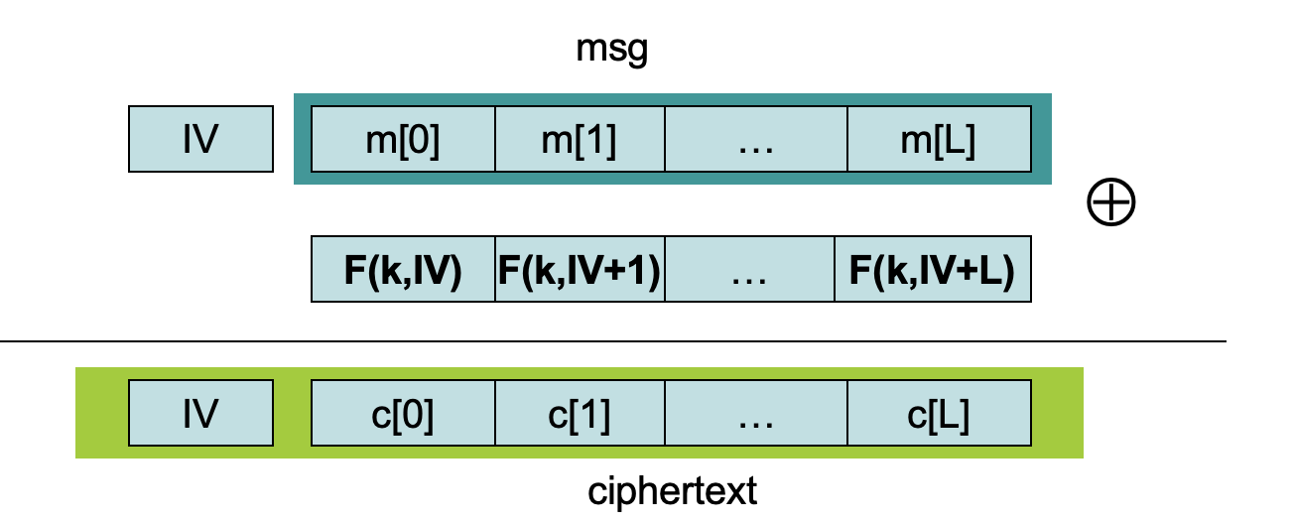
Construction 2’: nonce ctr-mode
To ensure F(k,x) is never used more than once, choose IV as:
128 bits
IV:
nonce
0000000
starts at 0
for every msg
96 bits
32 bits
IV+1:
nonce
0000001
IV+2:
nonce
0000002

Slide 21
Comparison: ctr vs. CBC
 | CBC | ctr mode
required primitive | PRP | PRF
parallel processing | No | Yes
security | q^2 L^2 << |X| | q^2 L << |X|
dummy padding block | Yes* | No
1 byte msgs (nonce-based) | 16x expansion | no expansion
* for CBC, dummy padding block can be avoided using ciphertext stealing

Slide 22
Summary
PRPs and PRFs: a useful abstraction of block ciphers.
We examined two security notions:
  Semantic security against one-time.
  Semantic security against many-time CPA.
  Note: neither mode ensures data integrity.
Stated security results summarized in the following table:
 | one-time key | Many-time key (CPA) | CPA and CT integrity
Sem. Sec. | steam-ciphers det. ctr-mode | rand CBC rand ctr-mode | later
Power
Goal

Slide 23
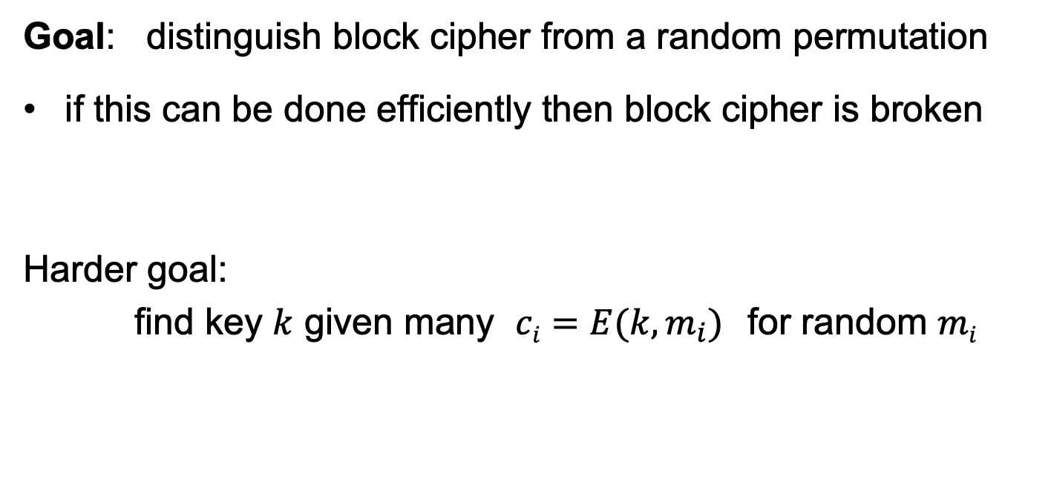
Attacks on block ciphers
Goal: distinguish block cipher from a random permutation
if this can be done efficiently then block cipher is broken
Harder goal:
find key $k$ given many $ci=E(k,m_{i})$for random $mi$

Slide 24
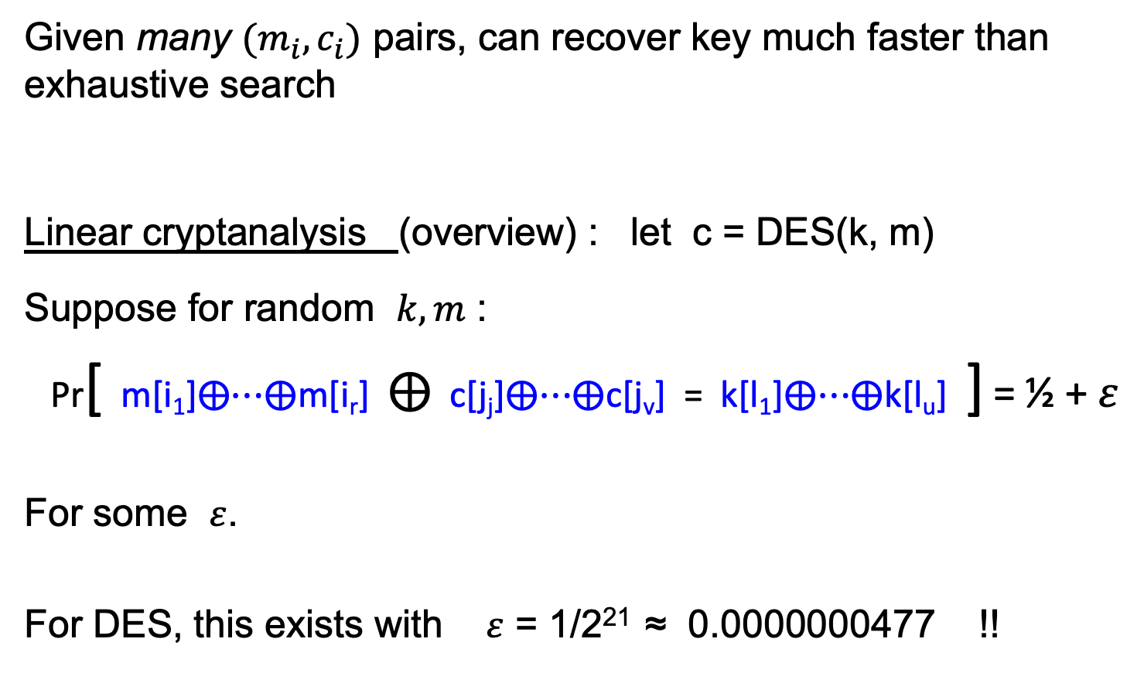
(1) Linear and differential attacks [BS’89,M’93]
Given many $(m_{i}, c_{i})$ pairs, can recover key much faster than exhaustive search
Linear cryptanalysis (overview) : let c = DES(k, m)
Suppose for random $k,m$ :
Pr[ m[i₁]⨁⋯⨁m[i_{r}] ⨁ c[j_{j}]⨁⋯⨁c[j_{v}] = k[l₁]⨁⋯⨁k[l_{u}] ] = ½ + $ε$
For some $ε$.
For DES, this exists with $ε$ = 1/2²¹ ≈ 0.0000000477 !!
Notes:
If S-boxes were random, then ε = 1/2¹⁰

Slide 25
Linear attacks
Pr[ m[i₁]⨁⋯⨁m[i_{r}] ⨁ c[j_{j}]⨁⋯⨁c[j_{v}] = k[l₁]⨁⋯⨁k[l_{u}] ] = ½ + ε
Thm: given 1/ε² random pairs (m, c=DES(k, m)) then
k[l₁]⨁…⨁k[l_{u}] = MAJ[ m[i₁]⨁…⨁m[i_{r}] ⨁ c[j_{j}]⨁…⨁c[j_{v}] ]
with prob. ≥ 97.7%
⇒ with 1/ε² inp/out pairs can find k[l₁]⨁…⨁k[l_{u}] in time ≈1/ε²

Slide 26
Linear attacks
For DES, ε = 1/2²¹ ⇒
with 2⁴² inp/out pairs can find k[l₁]⨁…⨁k[l_{u}] in time 2⁴²
Roughly speaking: can find 14 key “bits” this way in time 2⁴²
Brute force remaining 56−14=42 bits in time 2⁴²
Attack time: ≈2⁴³ (≪ 2⁵⁶ ) with 2⁴² random inp/out pairs

Slide 27
Lesson
A tiny bit of linearly leads to a 2⁴² time attack.
⇒ don’t design ciphers yourself !!

Slide 28
(2) Side channel attacks on software AES
Attacker measures the time to compute AES128(k,m) for many random blocks m.
  Suppose that the 256-byte S table is not in L1 cache at the start of each invocation
  ⟹ time to encrypt reveals the order in which S entries are accessed
  ⟹ leaks info. that can compromise entire key
Lesson: don’t implement AES yourself !
Mitigation: AES-NI or use vetted software (e.g., BoringSSL)

Slide 29
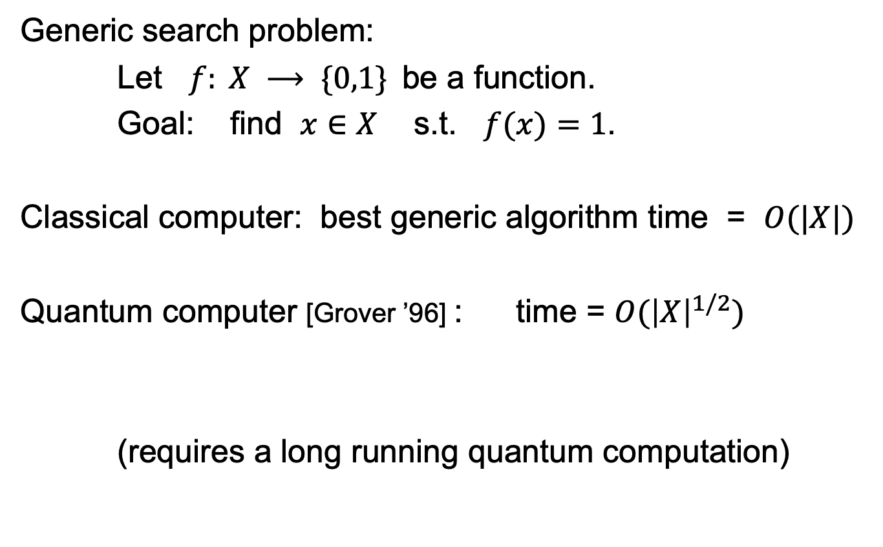
(3) Quantum attacks
Generic search problem:
Let $f: X ⟶ \{0,1\}$be a function.
Goal: find $x∈X$ s.t. $f(x)=1$.
Classical computer: best generic algorithm time = $O(|X|)$
Quantum computer [Grover ’96] : time = $O({\left|X\right|}^{1/2})$
(requires a long running quantum computation)

Slide 30

Quantum exhaustive search
Given m, c=E(k,m) define
Grover ⇒ quantum computer can find k in time O( |K|^{1/2} )
AES128: quantum key recovery time ≈2⁶⁴
Adversary has access to a quantum computer ⟹
encrypt data using a cipher with 256-bit keys (AES256)
if E(k,m) = c
0 otherwise
$$f(k) =$$

Slide 31
THE END

