Slide 1
PRPs and PRFs
CS255: Winter 2026
Dan Boneh, Stanford University

Slide 2
Recap
Simple stream ciphers:
can only use key to encrypt one message
Next goal: ciphers where a single key can be used to encrypt many messages
First, block ciphers …

Slide 3
Quick Recap
A block cipher is a pair of efficient algs. (E, D):
n bits
n bits
E, D
PT Block
CT Block
Key
k bits
Canonical examples:
AES: n=128 bits, k = 128, 192, 256 bits
3DES: n= 64 bits, k = 168 bits (historical)

Slide 4
Block Ciphers Built by Iteration
key k
key expansion
k₁
k₂
k₃
k_{n}
m
R(k₁, ⋅)
R(k₂, ⋅)
R(k₃, ⋅)
R(k_{n}, ⋅)
c
R(k,m) is called a round function
3DES: n=48, AES128: n=10, AES256: n=14

Slide 5
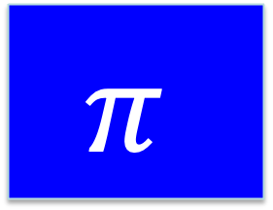





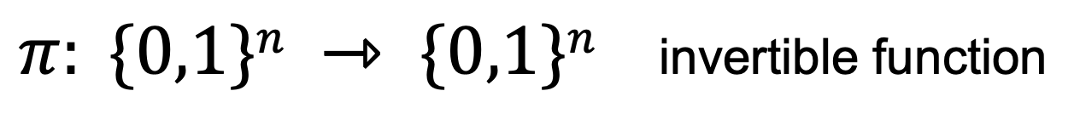
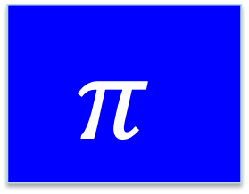
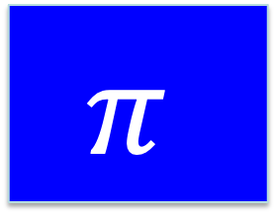
AES: an iterated Even-Mansour cipher
single round EM
$$π$$
$$π$$
$$π$$
input
⋯
⨁
⨁
⨁
⨁
$$k0$$
invertible
$$k1$$
$$k2$$
$$k_{d−1}$$
⨁
$$kd$$
output
key
key expansion:
$π: \{0,1\}n ⇾ \{0,1\}n$ invertible function

Slide 6
AES256: 14 rounds of EM
last
round
14 rounds
4
ByteSub
ShiftRow
MixColumn
ByteSub
ShiftRow
MixColumn
ByteSub
ShiftRow
input
⋯
4
⨁
⨁
⨁
⨁
k₀
invertible
k₁
k₂
k₁₃
16-byes
16-bytes
⨁
k₁₄
output
4
key
key expansion:
16 bytes ⟶240 bytes
4
32 bytes
(256 bits)

Slide 7
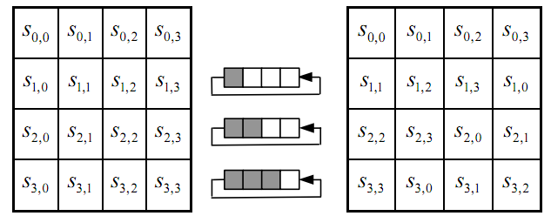
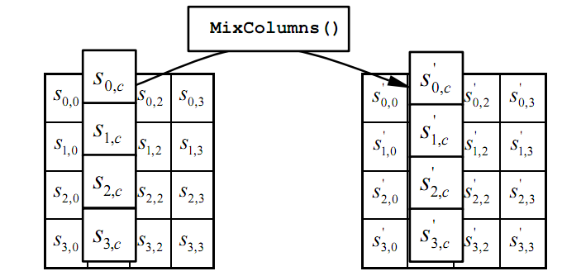

The permutation $π$
(1) ByteSub: a 1 byte S-box. 256 byte table. (invertible)
(2) ShiftRows:
(3) MixColumns:
Notes:
S-box is easily computable with little code. All three steps can be combined and accelerated with pre-computed tables.

Slide 8
Recall the AES pledge
I promise that I will not implement AES myself in production code, even though it might be fun. This agreement will remain in effect until I learn all about side-channel attacks and countermeasures to the point where I lose all interest in implementing AES myself.

Slide 9
Performance (no HW acceleration)
Cipher Block/key size Speed (MB/sec)
ChaCha20 - / 256 643
3DES 64 / 168 30
AES128 128 / 128 163
AES256 128 / 256 115
block

Slide 10
AES-NI: AES hardware instructions
AES instructions (Intel, AMD, ARM, …)
aesenc, aesenclast: do one round of AES
128-bit registers: xmm1=state, xmm2=round key
aesenc xmm1, xmm2 ; puts result in xmm1
aesdec, aesdeclast: one round of AES⁻¹
aeskeygenassist: performs AES key expansion
Claim 1: 20 x speed-up over OpenSSL on same hardware
Claim 2: constant time execution

Slide 11
AES-NI: Encrypting one block (AES256)
step 0: aeskeygenassist(256-bit key) ⟶
round keys in xmm2, xmm3, …, xmm16
step 1: load plaintext block into xmm1 (128-bit block)
step 2: xor xmm1, xmm2
aesenc xmm1, xmm3
aesenc xmm1, xmm4
aesenc xmm1, xmm5
…
aesenclast xmm1, xmm16
15 instructions

Slide 12
AES-NI: parallelism and pipelining
Intel Skylake (old): 4 cycles for one aesenc
    fully pipelined: can issue one instruction every cycle
Intel Icelake: vectorized aesenc (vaesenc)
    vaesenc: compute aesenc on four blocks in parallel
    fully pipelined: can issue one instruction every cycle
Implications:
AES256 encrypt a single block takes 56 cycles (14 rounds)
AES256 encrypt 16 blocks on Icelake takes 59 cycles

Slide 13
AES256 encrypt on Icelake
To encrypt 16 blocks do: m0, …, m15 ∈ {0,1}¹²⁸
0:
m0
m1
m2
m3
(vaesenc -- 512 bit register zmm1)
1:
m4
m5
m6
m7
(vaesenc)
2:
m8
m9
m10
m11
(vaesenc)
3:
m12
m13
m14
m15
(vaesenc)
(4 cycles)
4:
m0'
m1’
m2’
m3’
(vaesenc)
5:
m4’
m5’
m6’
m7’
(vaesenc)
… finish all 14 rounds after 59 cycles
time (cycles)

Slide 14
Abstract view of a block cipher:
PRPs and PRFs
Topics:
Abstract block ciphers: PRPs and PRFs
Security models for encryption
Analysis of CBC and counter mode

Slide 15
PRPs and PRFs
Pseudo Random Function (PRF) defined over (K,X,Y):
F: K × X → Y
such that exists “efficient” algorithm to evaluate F(k,x)
Pseudo Random Permutation (PRP) defined over (K,X):
E: K × X → X
such that:
1. Exists “efficient” algorithm to evaluate E(k,x)
2. The function E( k, ⋅ ) is one-to-one
3. Exists “efficient” inversion algorithm D(k,x)

Slide 16
Running example
Example PRPs: 3DES, AES, …
  AES256: K × X → X where X = {0,1}¹²⁸, K = {0,1}2⁵⁶
  3DES: K × X → X where X = {0,1}⁶⁴, K = {0,1}¹⁶⁸
Functionally, any PRP is also a PRF.
  A PRP is a PRF where X=Y and is efficiently invertible
  A PRP is sometimes called a block cipher

Slide 17
Secure PRFs
Let F: K × X → Y be a PRF
Funs[X,Y]: the set of all functions from X to Y
S_{F} = { F(k,⋅) s.t. k ∈ K } ⊆ Funs[X,Y]
Intuition: a PRF is secure if
a random function in Funs[X,Y] is indistinguishable from
a random function in S_{F}
Funs[X,Y]
S_{F}
Size |K|
Size |Y|^{|X|}

Slide 18
Secure PRFs
Let F: K × X → Y be a PRF
Funs[X,Y]: the set of all functions from X to Y
S_{F} = { F(k,⋅) s.t. k ∈ K } ⊆ Funs[X,Y]
Intuition: a PRF is secure if
a random function in Funs[X,Y] is indistinguishable from
a random function in S_{F}
f ← Funs[X,Y]
x ∈ X
???
k ← K
f(x) or F(k,x) ?

Slide 19


Secure PRF: defintion
For b=0,1 define experiment EXP(b) as:
Def: F is a secure PRF if for all “efficient” $𝒜$:
Adv_{PRF}[$𝒜$,F] = |Pr[EXP$(0)=1$] – Pr[EXP$(1)=1$] |
is “negligible.”
b
Chal.
b=0: k←K, f ←F(k,⋅)
b=1: f←Funs[X,Y]
Adv. $𝒜$
x_{i} ∈ X
f(x_{i})
b’ ∈ {0,1}

Slide 20
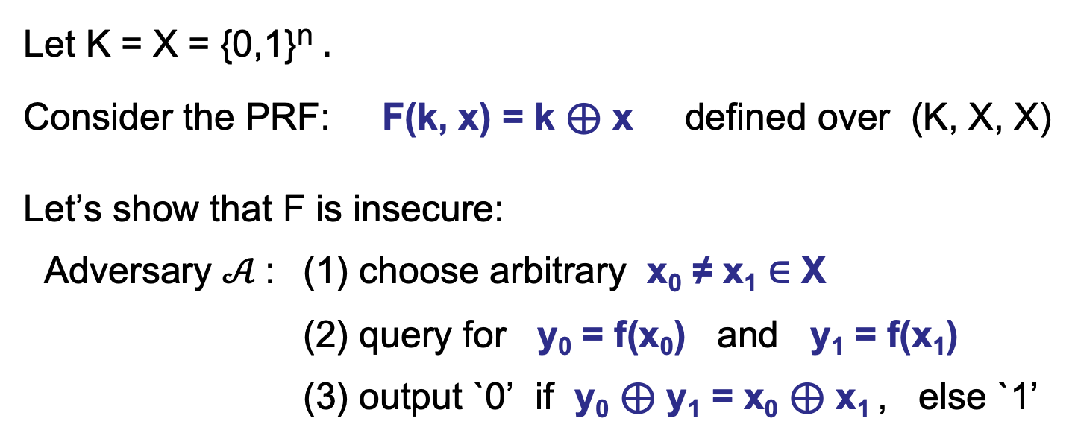
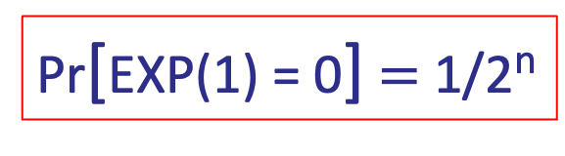
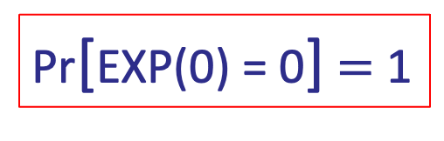
An example
Let K = X = {0,1}^{n} .
Consider the PRF: F(k, x) = k ⊕ x defined over (K, X, X)
Let’s show that F is insecure:
Adversary $𝒜$: (1) choose arbitrary x₀ ≠ x₁ ∈ X
(2) query for y₀ = f(x₀) and y₁ = f(x₁)
(3) output `0’ if y₀ ⊕ y₁ = x₀ ⊕ x₁ , else `1’
Pr[EXP(0) = 0] $=$ 1
Pr[EXP(1) = 0] $=$ 1/2^{n}
⟹ Adv_{PRF}[$𝒜$,F] $=1 − (1/2n)$ (not negligible)

Slide 21

Secure PRP
For b=0,1 define experiment EXP(b) as:
Def: E is a secure PRP if for all “efficient” $𝒜$:
Adv_{PRP}[$𝒜$,E] = |Pr[EXP$(0)=1$] – Pr[EXP$(1)=1$] |
is “negligible.”
b
Chal.
b=0: k←K, f ←E(k,⋅)
b=1: f←Perms[X]
Adv. $𝒜$
x_{i} ∈ X
f(x_{i})
b’ ∈ {0,1}

Slide 22
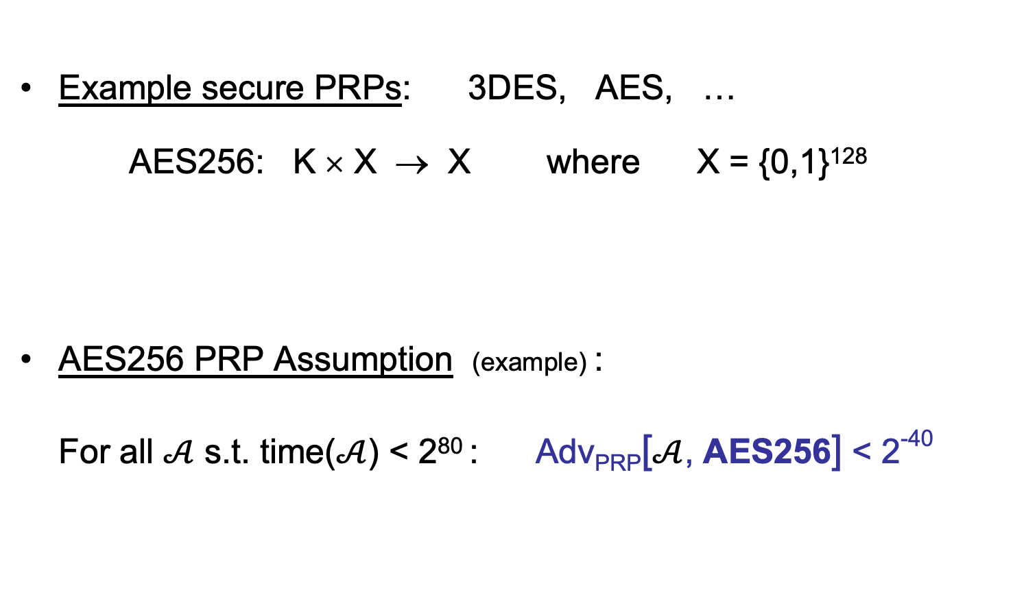
Example secure PRPs
Example secure PRPs: 3DES, AES, …
AES256: K × X → X where X = {0,1}¹²⁸
AES256 PRP Assumption (example) :
For all $𝒜$ s.t. time($𝒜$) < 2⁸⁰ : Adv_{PRP}[$𝒜$, AES256] < 2⁻⁴⁰
K = {0,1}²⁵⁶

Slide 23
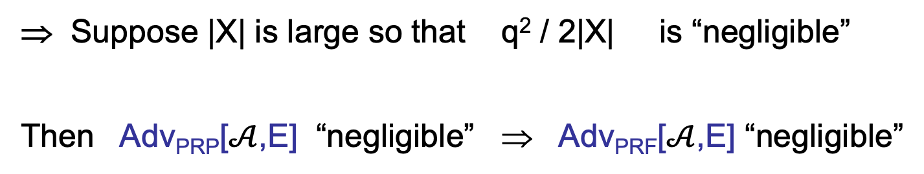
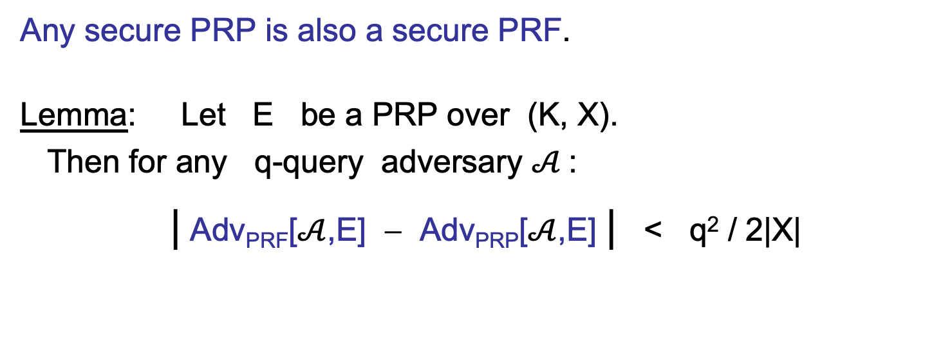
The PRP-PRF Switching Lemma
Any secure PRP is also a secure PRF.
Lemma: Let E be a PRP over (K, X).
Then for any q-query adversary $𝒜$:
| Adv_{PRF}[$𝒜$,E] − Adv_{PRP}[$𝒜$,E] | < q² / 2|X|
(proof follows from bounds on the birthday paradox)
⇒ Suppose |X| is large so that q² / 2|X| is “negligible”
Then Adv_{PRP}[$𝒜$,E] “negligible” ⇒ Adv_{PRF}[$𝒜$,E] “negligible”

Slide 24
Using PRPs and PRFs
Goal: build “secure” encryption from a PRP

Slide 25
Incorrect use of a PRP
Electronic Code Book (ECB):
Problem:
  if m₁=m₂ then c₁=c₂
PT:
m₁
m₂
CT:
c₁
c₂

Slide 26
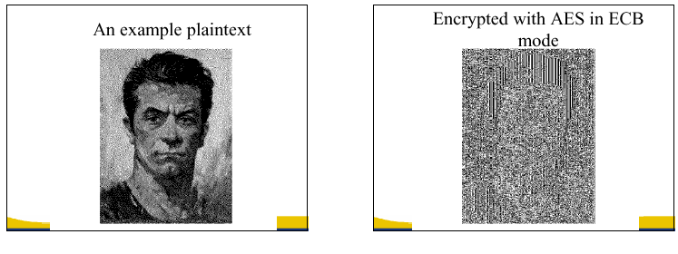
In pictures
(courtesy B. Preneel)

Slide 27
Modes of Operation for
One-time Use Key
How to use a block cipher?
Example application:
Encrypted email. New key for every message.

Slide 28


Semantic Security for one-time key
E = (E,D) a cipher defined over (K,M,C)
For b=0,1 define EXP(b) as:
Def: E is sem. sec. for one-time key if for all “efficient” $𝒜$:
Adv_{SS}[$𝒜$,E] = |Pr[EXP(0)=1] – Pr[EXP(1)=1] |
is “negligible.”
b
Chal.
Adv. $𝒜$
k←K
m₀ , m₁ ∈ M : |m₀| = |m₁|
c ← E(k, m_{b})
b’ ∈ {0,1}

Slide 29
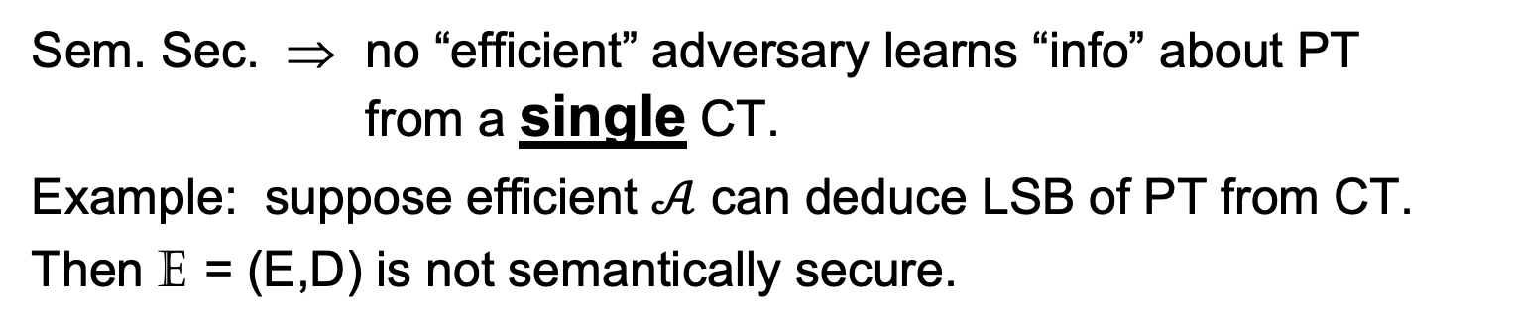

Semantic security (cont.)
Sem. Sec. ⇒ no “efficient” adversary learns “info” about PT from a single CT.
Example: suppose efficient $𝒜$ can deduce LSB of PT from CT.
Then E = (E,D) is not semantically secure.
b∈{0,1}
  m₀, LSB(m₀)=0
  m₁, LSB(m₁)=1
Adv. B (us)
Chal.
k←K
Adv. $𝒜$
(given)
c ← E(k, m_{b})
c
LSB(m_{b})=b
Then Adv_{SS}[B, E] = 1 ⇒ E is not sem. sec.
Notes:
The same holds for any predicate P where Pr[P(x)=0] is bounded away from 0 and 1.

Slide 30
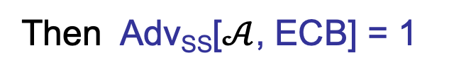
Note: ECB is not Sem. Sec.
ECB is not semantically secure for messages that contain
two or more blocks.
b∈{0,1}
Two blocks
Chal.
  m₀ = “Hello World”
  m₁ = “Hello Hello”
Adv. $𝒜$
k←K
(c₁,c₂) ← E(k, m_{b})
If c₁=c₂ output 1, else output 0
Then Adv_{SS}[$𝒜$, ECB] = 1

Slide 31
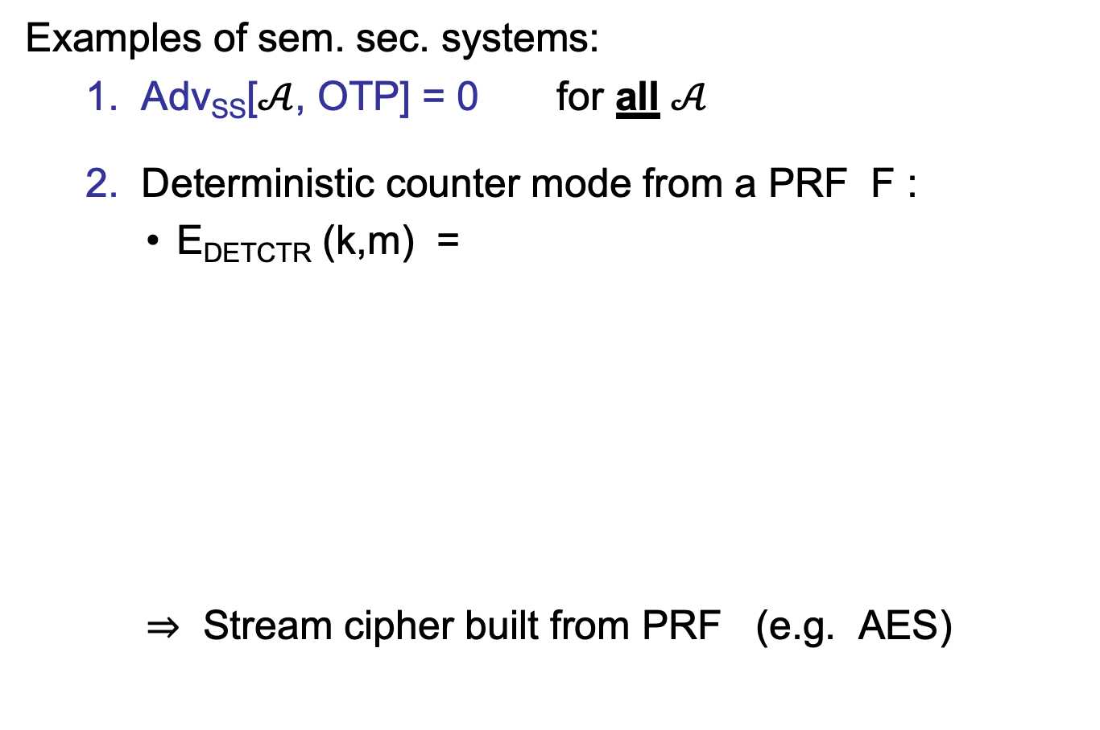
Secure Constructions
Examples of sem. sec. systems:
  1. Adv_{SS}[$𝒜$, OTP] = 0 for all $𝒜$
  2. Deterministic counter mode from a PRF F :
    E_{DETCTR} (k,m) =
    ⇒ Stream cipher built from PRF (e.g. AES)
m[0]
m[1]
…
m[L]
⊕
F(k,0)
F(k,1)
…
F(k,L)
indist. from
a OTP
c[0]
c[1]
…
c[L]

Slide 32
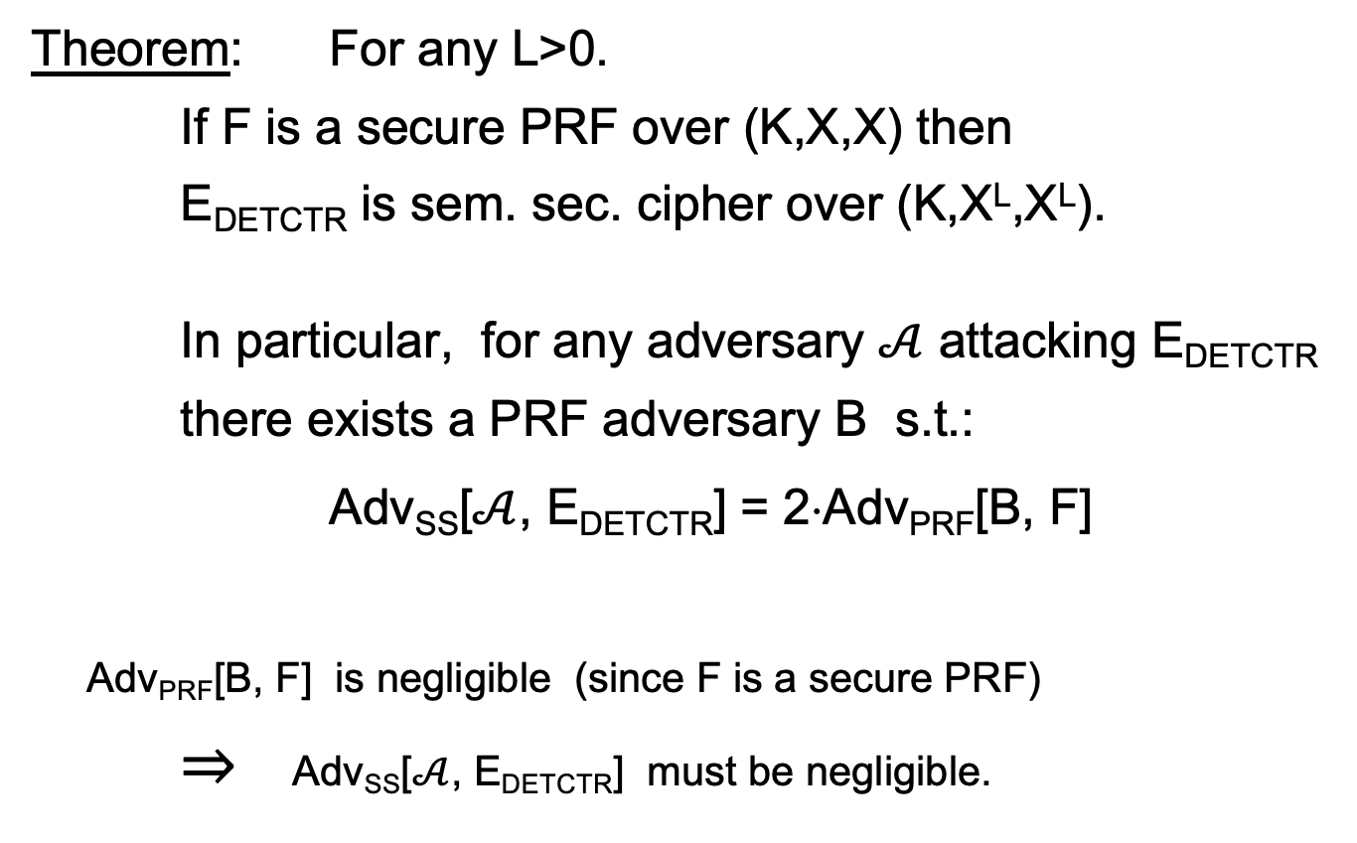
Det. counter-mode security
Theorem: For any L>0.
If F is a secure PRF over (K,X,X) then
E_{DETCTR} is sem. sec. cipher over (K,X^{L},X^{L}).
In particular, for any adversary $𝒜$ attacking E_{DETCTR} there exists a PRF adversary B s.t.:
Adv_{SS}[$𝒜$, E_{DETCTR}] = 2⋅Adv_{PRF}[B, F]
Adv_{PRF}[B, F] is negligible (since F is a secure PRF)
⇒ Adv_{SS}[$𝒜$, E_{DETCTR}] must be negligible.

Slide 33
Modes of Operation for
Many-time Key
Example applications:
1. File systems: Same AES key used to encrypt many files.
2. IPsec: Same AES key used to encrypt many packets.

Slide 34


Semantic Security for many-time key (CPA security)
Cipher E = (E,D) defined over (K,M,C).
For b=0,1 define EXP(b) as:
Def: E is sem. sec. under CPA if for all “efficient” $𝒜$:
Adv_{CPA} [$𝒜$,E] = |Pr[EXP(0)=1] – Pr[EXP(1)=1] |
is “negligible.”
b ∈ {0,1}
for i=1,…,q:
Chal.
Adv. $𝒜$
k←K
m_{i,0} , m_{i,1} ∈ M : |m_{i,0}| = |m_{i,1}|
c_{i} ← E(k, m_{i,b})
b’ ∈ {0,1}
if adv. wants c = E(k, m) it queries with m_{j,0}= m_{j,1}=m

Slide 35
Security for many-time key
Fact: stream ciphers are insecure under CPA.
  More generally: if E(k,m) always produces same ciphertext, then cipher is insecure under CPA.
If secret key is to be used multiple times ⇒
given the same plaintext message twice,
the encryption alg. must produce different outputs.
Chal.
m₀ , m₀ ∈ M
Adv.
k←K
c₀ ←E(k, m₀)
m₀ , m₁ ∈ M
output 0
if c = c₀
c ← E(k, m_{b})

Slide 36
Nonce-based Encryption
nonce
Alice
Bob
m, n
E
E(k,m,n)=c
c, n
D
D(k,c,n)=m
k
k
nonce n: a value that changes from msg to msg
  (k,n) pair never used more than once
method 1: encryptor chooses a random nonce, n ← N
method 2: nonce is a counter (e.g. packet counter)
  used when encryptor keeps state from msg to msg
  if decryptor has same state, need not send nonce with CT
Notes:
File encryption: random nonce, no state from file to file
SSL encrytpion (in order delivery): counter is fine, no need to send nonce to peer.
IP sec (out of order delivery): counter is fine, but need to include nonce in every packet.

Slide 37
Construction 1: CBC with random nonce
Cipher block chaining with a random IV (IV = nonce)
IV
m[0]
m[1]
m[2]
m[3]
⊕
⊕
⊕
⊕
E(k,⋅)
E(k,⋅)
E(k,⋅)
E(k,⋅)
IV
c[0]
c[1]
c[2]
c[3]
ciphertext
note: CBC where attacker can predict the IV is not CPA-secure. HW.

Slide 38
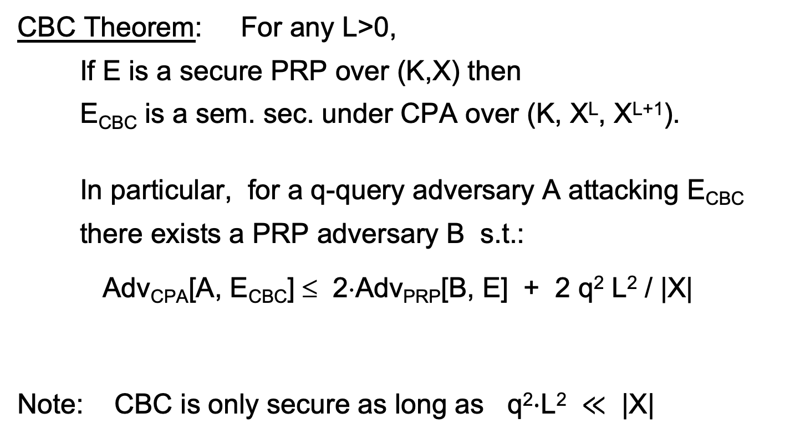
CBC: CPA Analysis
CBC Theorem: For any L>0,
If E is a secure PRP over (K,X) then
E_{CBC} is a sem. sec. under CPA over (K, X^{L}, X^{L+1}).
In particular, for a q-query adversary A attacking E_{CBC}
there exists a PRP adversary B s.t.:
Adv_{CPA}[A, E_{CBC}] ≤ 2⋅Adv_{PRP}[B, E] + 2 q² L² / |X|
Note: CBC is only secure as long as q²⋅L² $≪$ |X|
# messages enc. with key
max msg length

Slide 39
Construction 1’: CBC with unique nonce
Cipher block chaining with unique IV (IV = nonce)
unique IV means: (key,IV) pair is used for only one message
IV
m[0]
m[1]
m[2]
m[3]
IV′
⊕
⊕
⊕
⊕
E(k₂,⋅)
E(k₁,⋅)
E(k₁,⋅)
E(k₁,⋅)
E(k₁,⋅)
IV
c[0]
c[1]
c[2]
c[3]
ciphertext
included only if unknown to decryptor

Slide 40
A CBC technicality: padding
IV
m[0]
m[1]
m[2]
m[3] ll pad
IV′
⊕
⊕
⊕
⊕
E(k₁,⋅)
E(k,⋅)
E(k,⋅)
E(k,⋅)
E(k,⋅)
IV
c[0]
c[1]
c[2]
c[3]
pad is
removed
during
decryption
TLS 1.0: if need n-byte pad, n>0, use:
if no pad needed, add a dummy block
n-1
n-1
⋯
n-1
Notes:
Solution: ciphertext stealing, but not discussed here.
Later: when removing pad must verify its structure, otherwise Poodle attack.

Slide 41

Construction 2: rand ctr-mode
F: PRF defined over (K,X,Y) where X = $\{0,1,…,2n$-$1\}$and Y = $\{0,1\}n$
(e.g., n=128)
msg
IV
m[0]
m[1]
…
m[L]
⊕
F(k,IV)
F(k,IV+1)
…
F(k,IV+L)
(counter counts mod $2^{n}$)
IV
c[0]
c[1]
…
c[L]
ciphertext
IV - chosen at random for every message
note: parallelizable (unlike CBC)

Slide 42
Why is this CPA secure?
the set X: domain of PRF
IV₃
IV₃+1
⋯
IV₃+L
msg3
IV₁
IV₁+1
⋯
IV₁+L
msg1
msg5
msg4
IV₂
IV₂+1
⋯
IV₂+L
msg2
CPA security holds as long as intervals do not intersect
q msgs, L blocks each ⇒ Pr[ intersection ] ≤ 2 q² L / |X|
needs to be negligible

Slide 43
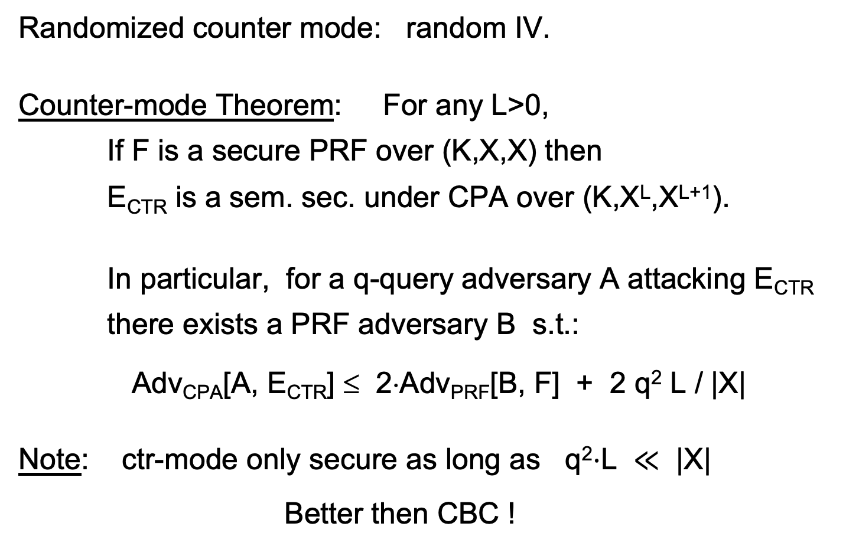
rand ctr-mode: CPA analysis
Randomized counter mode: random IV.
Counter-mode Theorem: For any L>0,
If F is a secure PRF over (K,X,X) then
E_{CTR} is a sem. sec. under CPA over (K,X^{L},X^{L+1}).
In particular, for a q-query adversary A attacking E_{CTR}
there exists a PRF adversary B s.t.:
Adv_{CPA}[A, E_{CTR}] ≤ 2⋅Adv_{PRF}[B, F] + 2 q² L / |X|
Note: ctr-mode only secure as long as q²⋅L $≪$ |X|
Better then CBC !

Slide 44
An example
Adv_{CPA} [A, E_{CTR}] ≤ 2⋅Adv_{PRF}[B, E] + 2 q² L / |X|
q = # messages encrypted with k , L = length of max msg
Suppose we want Adv_{CPA}[A, E_{CTR}] ≤ 1/ 2³¹
Then need: q² L / |X| ≤ 1/ 2³²
AES: |X| = 2¹²⁸ ⇒ q L^{1/2} < 2⁴⁸
So, after 2³² CTs each of len 2³² , must change key
(total of 2⁶⁴ AES blocks)

Slide 45
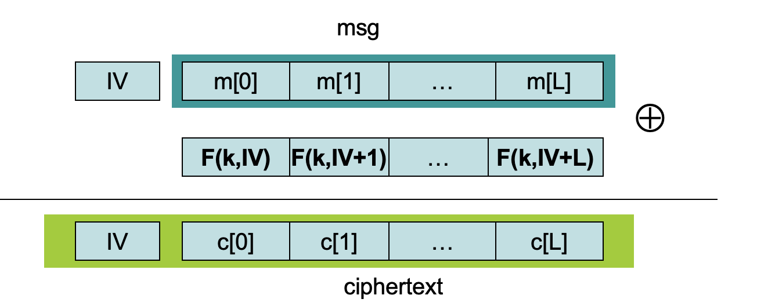
Construction 2’: nonce ctr-mode
To ensure F(k,x) is never used more than once, choose IV as:
128 bits
IV:
nonce
0000000
starts at 0
for every msg
96 bits
32 bits
IV+1:
nonce
0000001
IV+2:
nonce
0000002

Slide 46
Comparison: ctr vs. CBC
 | CBC | ctr mode
required primitive | PRP | PRF
parallel processing | No | Yes
security | q^2 L^2 << |X| | q^2 L << |X|
dummy padding block | Yes* | No
1 byte msgs (nonce-based) | 16x expansion | no expansion
* for CBC, dummy padding block can be avoided using ciphertext stealing

Slide 47
Summary
PRPs and PRFs: a useful abstraction of block ciphers.
We examined two security notions:
  Semantic security against one-time.
  Semantic security against many-time CPA.
  Note: neither mode ensures data integrity.
Stated security results summarized in the following table:
 | one-time key | Many-time key (CPA) | CPA and CT integrity
Sem. Sec. | steam-ciphers det. ctr-mode | rand CBC rand ctr-mode | later
Power
Goal

Slide 48
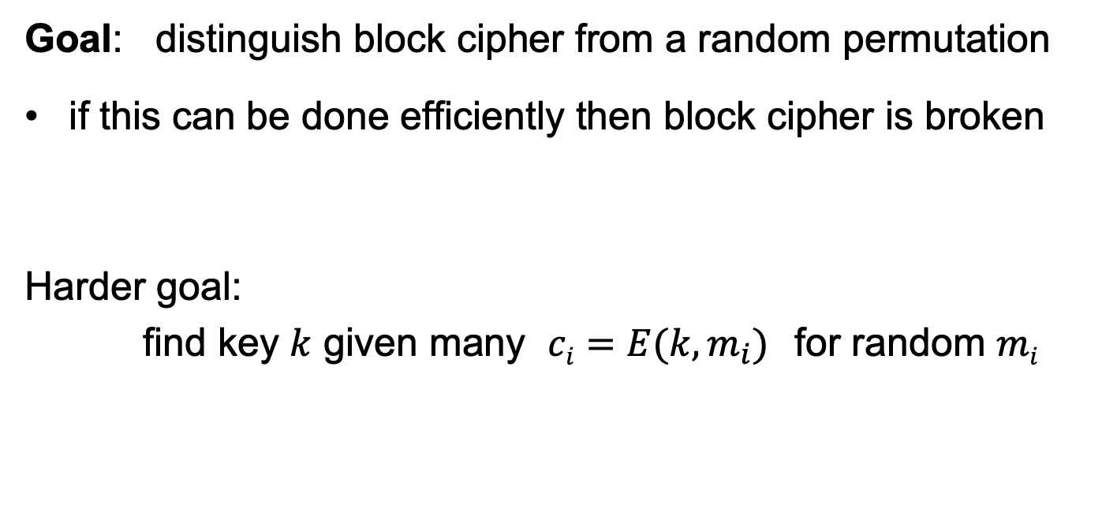
Attacks on block ciphers
Goal: distinguish block cipher from a random permutation
if this can be done efficiently then block cipher is broken
Harder goal:
find key $k$ given many $ci=E(k,m_{i})$for random $mi$

Slide 49
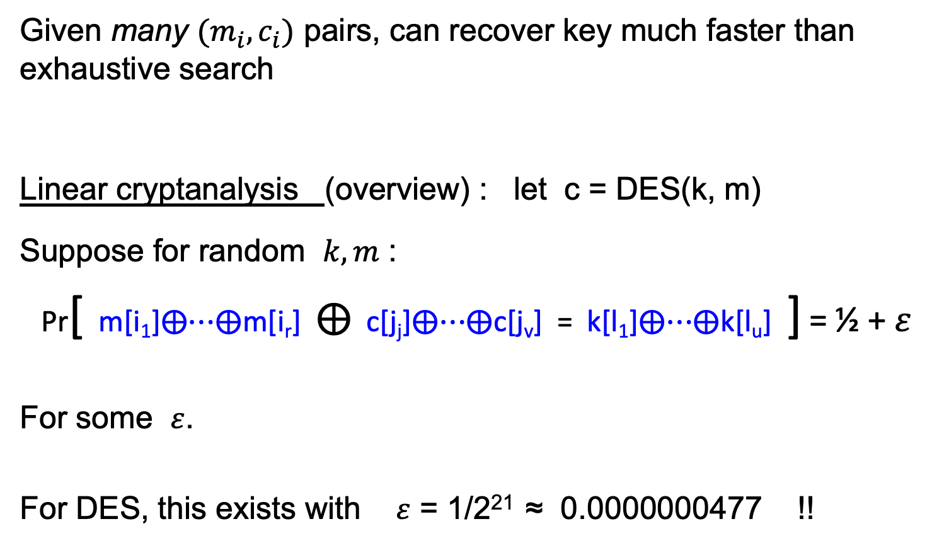
(1) Linear and differential attacks [BS’89,M’93]
Given many $(m_{i}, c_{i})$ pairs, can recover key much faster than exhaustive search
Linear cryptanalysis (overview) : let c = DES(k, m)
Suppose for random $k,m$ :
Pr[ m[i₁]⨁⋯⨁m[i_{r}] ⨁ c[j_{j}]⨁⋯⨁c[j_{v}] = k[l₁]⨁⋯⨁k[l_{u}] ] = ½ + $ε$
For some $ε$.
For DES, this exists with $ε$ = 1/2²¹ ≈ 0.0000000477 !!
Notes:
If S-boxes were random, then ε = 1/2¹⁰

Slide 50
Linear attacks
Pr[ m[i₁]⨁⋯⨁m[i_{r}] ⨁ c[j_{j}]⨁⋯⨁c[j_{v}] = k[l₁]⨁⋯⨁k[l_{u}] ] = ½ + ε
Thm: given 1/ε² random pairs (m, c=DES(k, m)) then
k[l₁]⨁…⨁k[l_{u}] = MAJ[ m[i₁]⨁…⨁m[i_{r}] ⨁ c[j_{j}]⨁…⨁c[j_{v}] ]
with prob. ≥ 97.7%
⇒ with 1/ε² inp/out pairs can find k[l₁]⨁…⨁k[l_{u}] in time ≈1/ε²

Slide 51
Linear attacks
For DES, ε = 1/2²¹ ⇒
with 2⁴² inp/out pairs can find k[l₁]⨁…⨁k[l_{u}] in time 2⁴²
Roughly speaking: can find 14 key “bits” this way in time 2⁴²
Brute force remaining 56−14=42 bits in time 2⁴²
Attack time: ≈2⁴³ ( << 2⁵⁶ ) with 2⁴² random inp/out pairs

Slide 52
Lesson
A tiny bit of linearly leads to a 2⁴² time attack.
⇒ don’t design ciphers yourself !!

Slide 53
(2) Side channel attacks on software AES
Attacker measures the time to compute AES128(k,m) for many random blocks m.
  Suppose that the 256-byte S table is not in L1 cache at the start of each invocation
  ⟹ time to encrypt reveals the order in which S entries are accessed
  ⟹ leaks info. that can compromise entire key
Lesson: don’t implement AES yourself !
Mitigation: AES-NI or use vetted software (e.g., BoringSSL)

Slide 54
(3) Quantum attacks
Generic search problem:
Let f: X ⟶ {0,1} be a function.
Goal: find x∈X s.t. f(x)=1.
Classical computer: best generic algorithm time = O( |X| )
Quantum computer [Grover ’96] : time = O( |X|^{1/2} )
(requires a long running quantum computation)

Slide 55
Quantum exhaustive search
Given m, c=E(k,m) define
Grover ⇒ quantum computer can find k in time O( |K|^{1/2} )
AES128: quantum key recovery time ≈2⁶⁴
Adversary has access to a quantum computer ⟹
encrypt data using a cipher with 256-bit keys (AES256)
if E(k,m) = c
0 otherwise
f(k) =

Slide 56
THE END

Slide 57
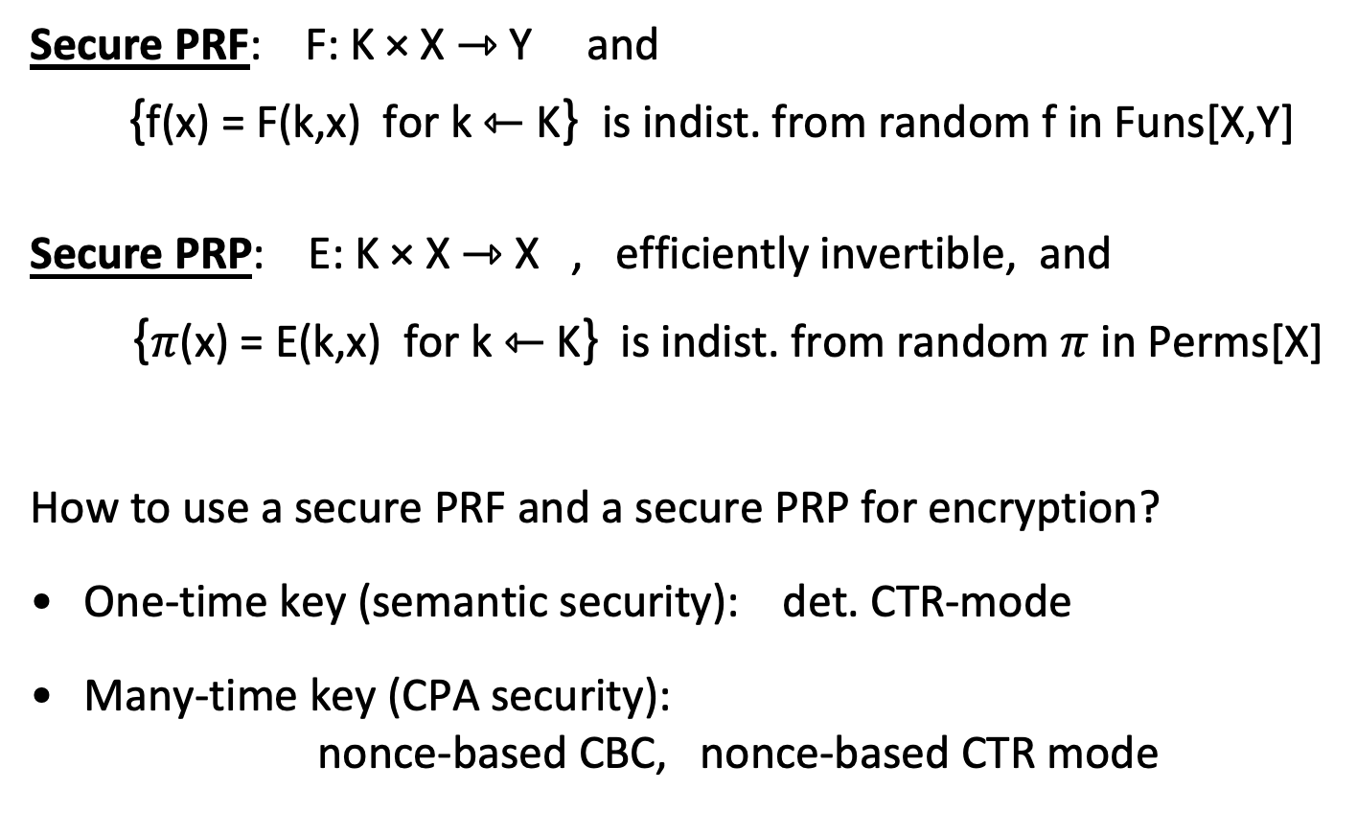
Recap
Secure PRF: F: K × X ⇾ Y and
{f(x) = F(k,x) for k ⇽ K} is indist. from random f in Funs[X,Y]
Secure PRP: E: K × X ⇾ X , efficiently invertible, and
{$π$(x) = E(k,x) for k ⇽ K} is indist. from random $π$ in Perms[X]
How to use a secure PRF and a secure PRP for encryption?
One-time key (semantic security): det. CTR-mode
Many-time key (CPA security):
nonce-based CBC, nonce-based CTR mode

